Slide 1


Today’s Agenda
ABP Community News 💁 Alper
What’s new with ABP 9 💁 Alper
C# 13 🙋 Ahmet
.NET Libraries & SDK 🙋 Ahmet
.NET Aspire 🧑 Berkan
ASP.NET Core 🧑 Berkan
.NET MAUI 🙎 Engin
Entity Framework Core 🙎 Engin
Q & A session
Raffle Results

Slide 2




ABP Community News
What’s new with ABP 9 ?
Alper EBICOGLU
@alperebicoglu
ABP Core Team Member
@ebicoglu

Slide 3

Thanks to JetBrains for Sponsoring

Slide 4



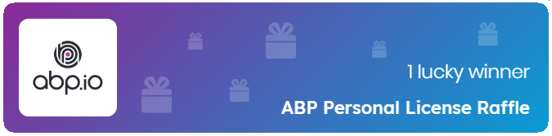

Today’s Gifts
Scan QR codes
Or visit
https://abp.io/community/raffles
👉
closes at 17:45 UTC
Notes:
3 JetBrains
https://admin.abp.io/Raffles/Draw/3a163790-9c7d-69d9-52b3-bb7f2993b4d6
ABP Personal License
https://admin.abp.io/Raffles/Draw/3a163792-2523-f369-3f8f-42d6b4c3af62

Slide 5
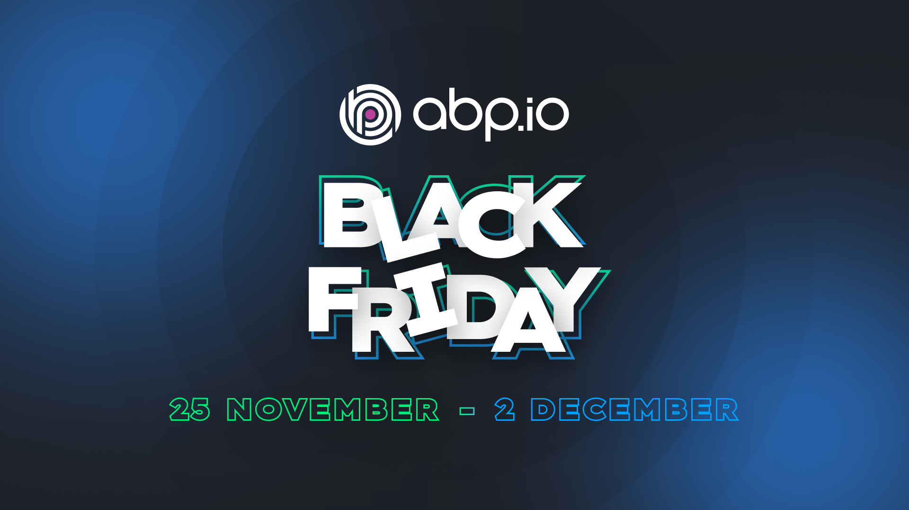
Black Friday 2024
Notes:
There will be a very good discount on ABP PRO licenses. Stay tuned!

Slide 6
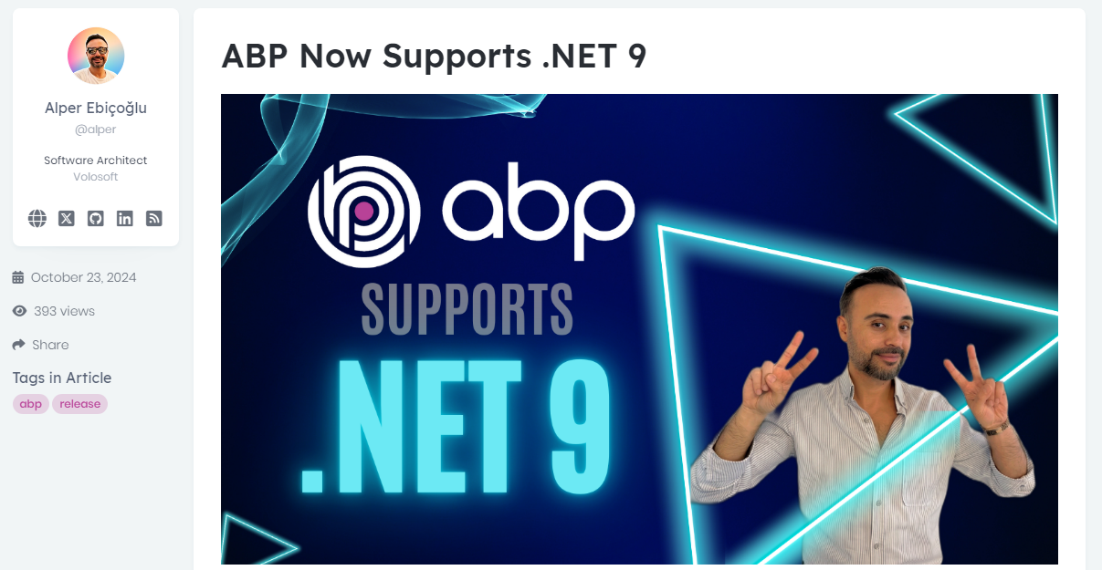

Community News
https://abp.io/community/articles/abp-now-supports-.net-9-zpkznc4f
Notes:
The ABP Platform is now compatible with .NET 9, bringing all the latest features of the framework to ABP developers.

Slide 7
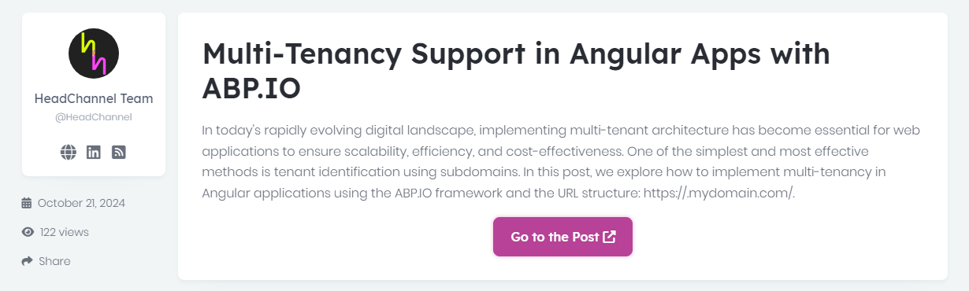

Community News
https://abp.io/community/articles/multitenancy-support-in-angular-apps-with-abp.io-lw9l36c5
Notes:
how to implement multi-tenant architecture in Angular applications using ABP Framework.

Slide 8
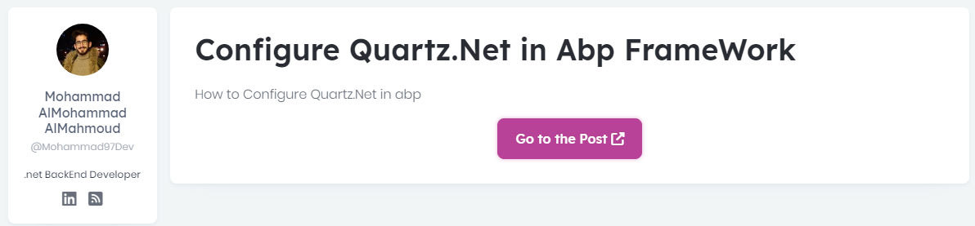

Community News
https://abp.io/community/articles/configure-quartz.net-in-abp-framework-3bveq4y1
Notes:
Step-by-step guide to using Quartz.Net in the ABP Framework for handling scheduled tasks and background jobs effectively.
But ABP is well-integrated to Quartz. So no need to do anything.

Slide 9
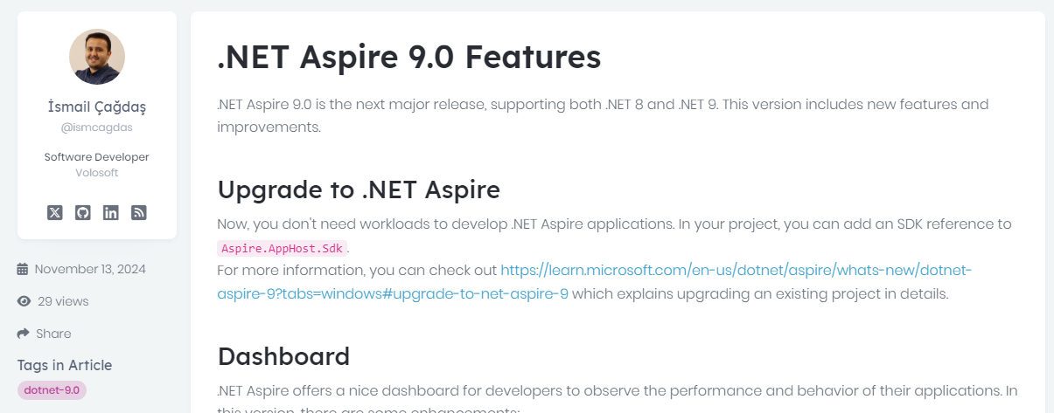

Community News
https://abp.io/community/articles/.net-aspire-9.0-features-q7nojisw

Slide 10
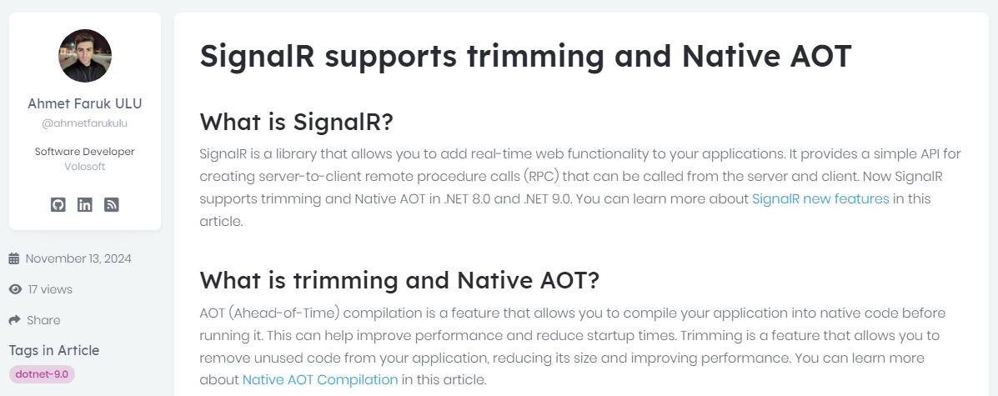

Community News
https://abp.io/community/articles/.net-9.0-signalr-supports-trimming-and-native-aot-4oxx0qbs
Notes:
SignalR comes with trimming and Native AOT support with .NET 9.

Slide 11
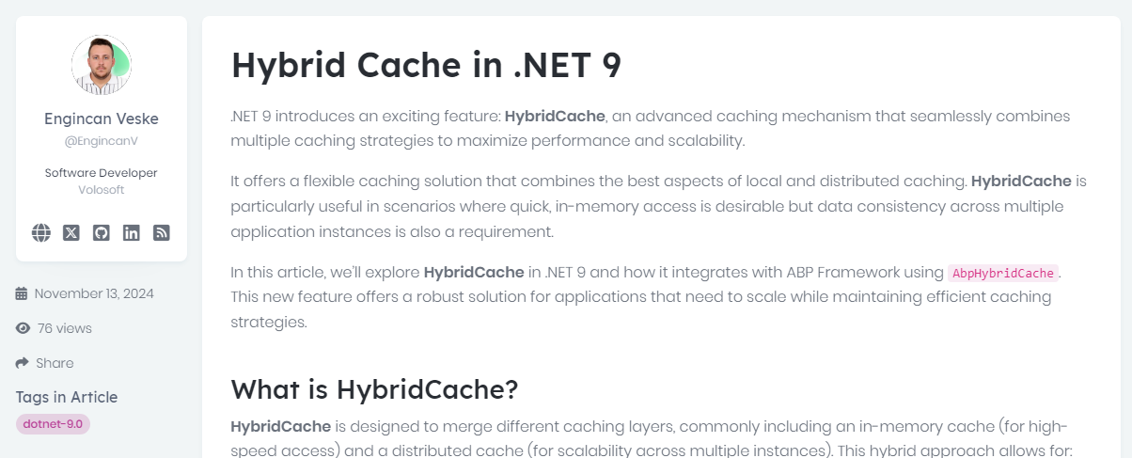

Community News
https://abp.io/community/articles/hybrid-cache-in-.net-9-5s0l2pa6
Notes:
With .NET 9, a new feature called HybridCache is announced.
It’s a new caching which combines multiple caching strategies to maximize performance and scalability.
Improves performance scalibity and allows automatic synchronization

Slide 12
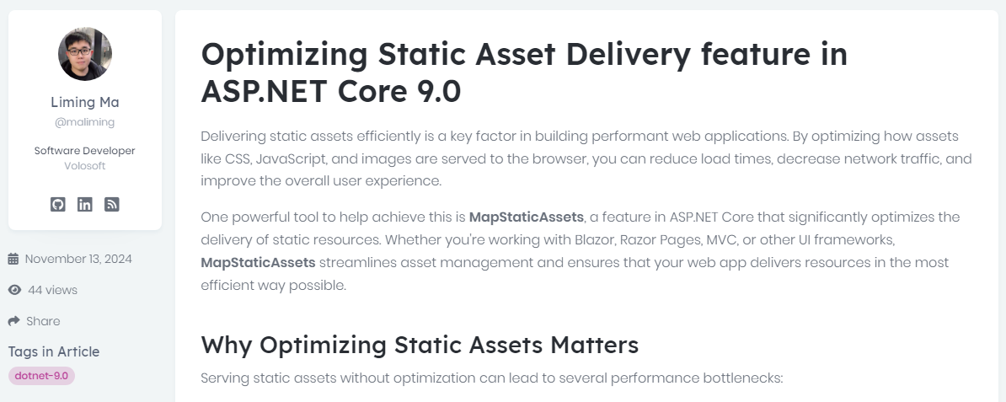
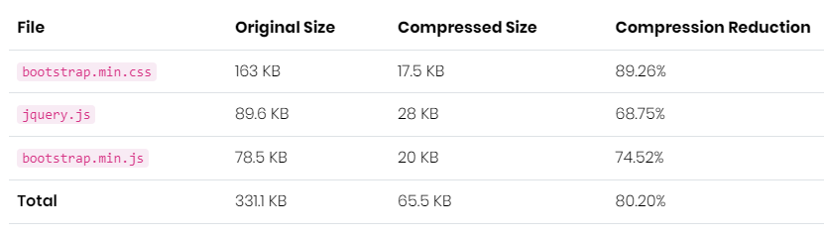

Community News
https://abp.io/community/articles/optimizing-static-asset-delivery-feature-in-asp.net-core-9.0-gyv140vb
Notes:
Optimizing Static Asset Delivery feature introduces the MapStaticAssets middleware.
Assets like CSS, JavaScript and Images are precompressed using gzip
In a default Razor Pages template, assets like bootstrap.min.css and jquery.js are compressed by over 80%.

Slide 13
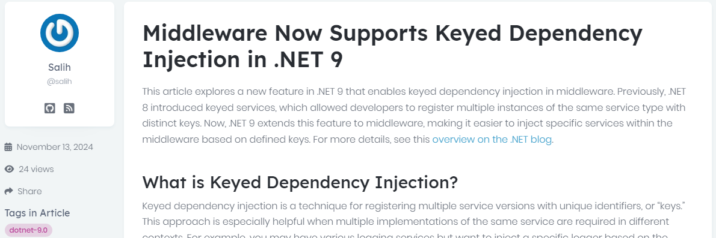

Community News
https://abp.io/community/articles/middleware-now-supports-keyed-dependency-injection-in-.net-9-4whni6rx
Notes:
In .NET 9, middleware components now support keyed dependency injection, allowing developers to inject specific service instances identified by unique keys directly into middleware classes.
Developers can register multiple implementations of the same service type, each associated with a unique key, and inject the desired instance into middleware by specifying the corresponding key.
This feature enables more granular control over middleware behavior by allowing different configurations or behaviors based on the injected service instance.

Slide 14
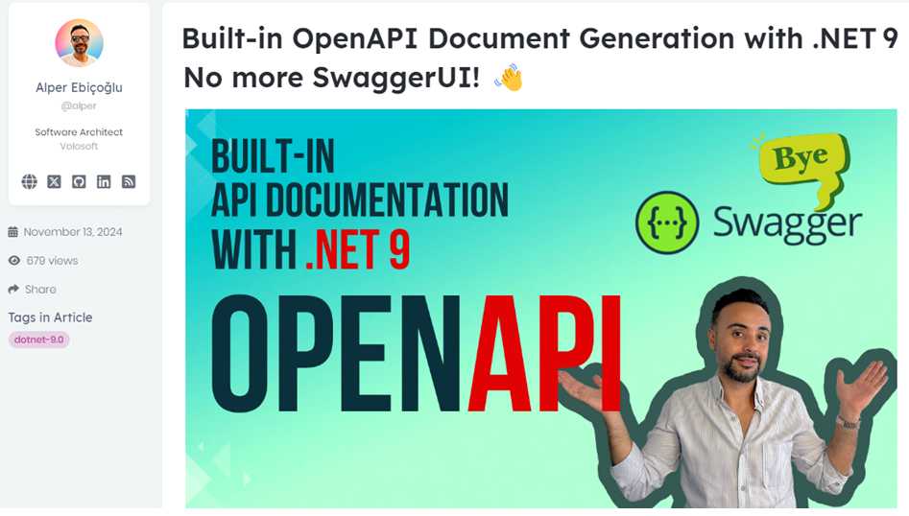

Community News
https://abp.io/community/articles/builtin-openapi-document-generation-with-.net-9-no-more-swaggerui--au56cck5
Notes:
In .NET 9 web templates Swagger is removed . Microsoft introduced a new package called OpenAPI.

Slide 15
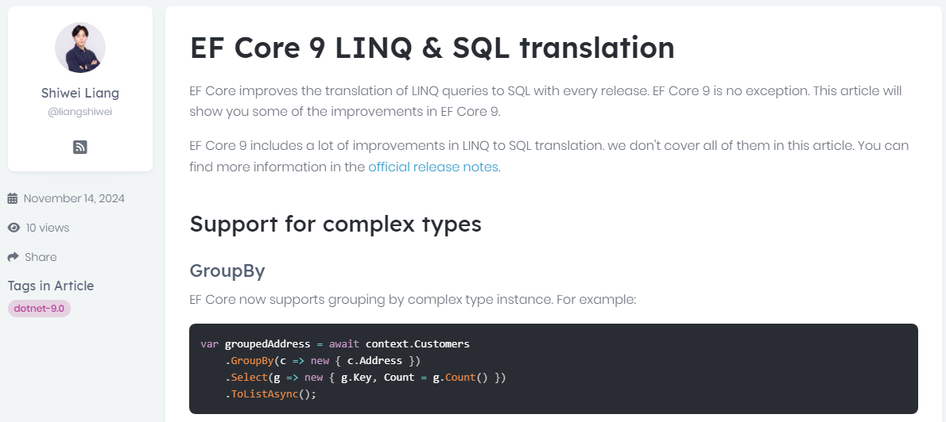

Community News
https://abp.io/community/articles/ef-core-9-linq-sql-translation-b7pzcj09
Notes:
In Entity Framework Core 9, LINQ-to-SQL translation has been significantly improved, allowing more complex LINQ queries to be accurately converted into SQL.
These enhancements reduce runtime errors and optimize database performance, making it easier for developers to write efficient and expressive queries.

Slide 16
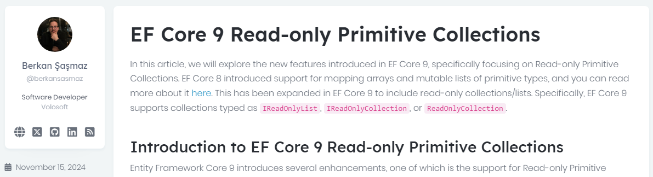

Community News
https://abp.io/community/articles/ef-core-9-readonly-primitive-collections-iy6ztbx8
Notes:
Berkan is explaining the enhancements of Read-only Primitive Collections in EF Core 9.

Slide 17
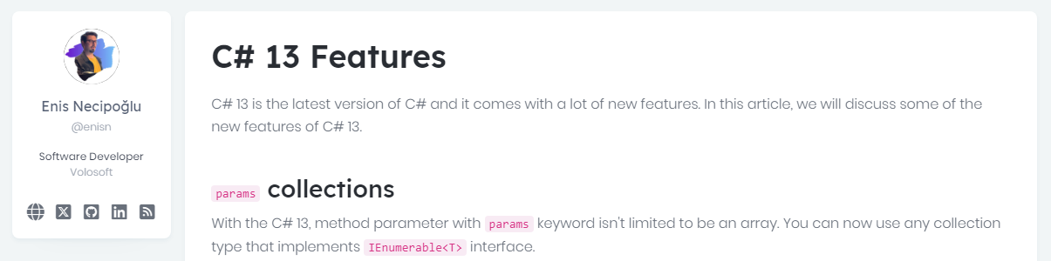

Community News
https://abp.io/community/articles/c-13-features-1aq5pzuy
Notes:
Enis summarizes the comings with C#13.

Slide 18
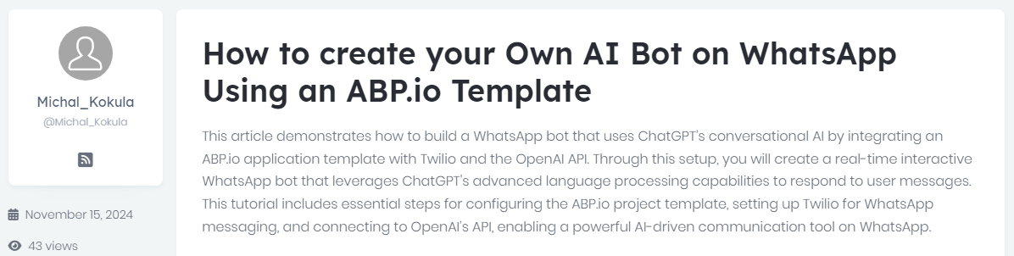

Community News
https://abp.io/community/articles/how-to-create-your-own-ai-bot-on-whatsapp-using-the-abp-framework-c6jgvt9c
Notes:
Michal Kokula wrote an article about AI Bots, WhatsApp, Twilio and ABP.
In this post, he demonstrates how to build a WhatsApp chat bot which uses ChatGPT’s conversational AI on top of ABP.IO application template with Twilio integration.

Slide 19
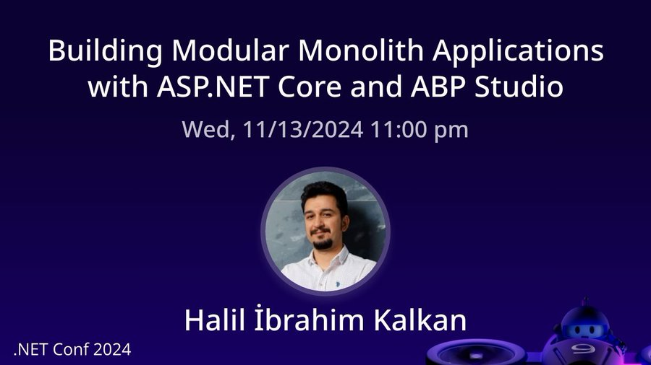

Community News
Notes:
Last week, the .NET Conf ‘24 conference was held online.
Lead developer of ABP gave a talk in .NET Conf 2024.
The topic was “Building Modular Applications with ASP.NET Core & ABP”
In his session, he discussed building modular applications and mentioned how ABP Studio makes it easier to create fully modular systems with ASP.NET Core.

Slide 20
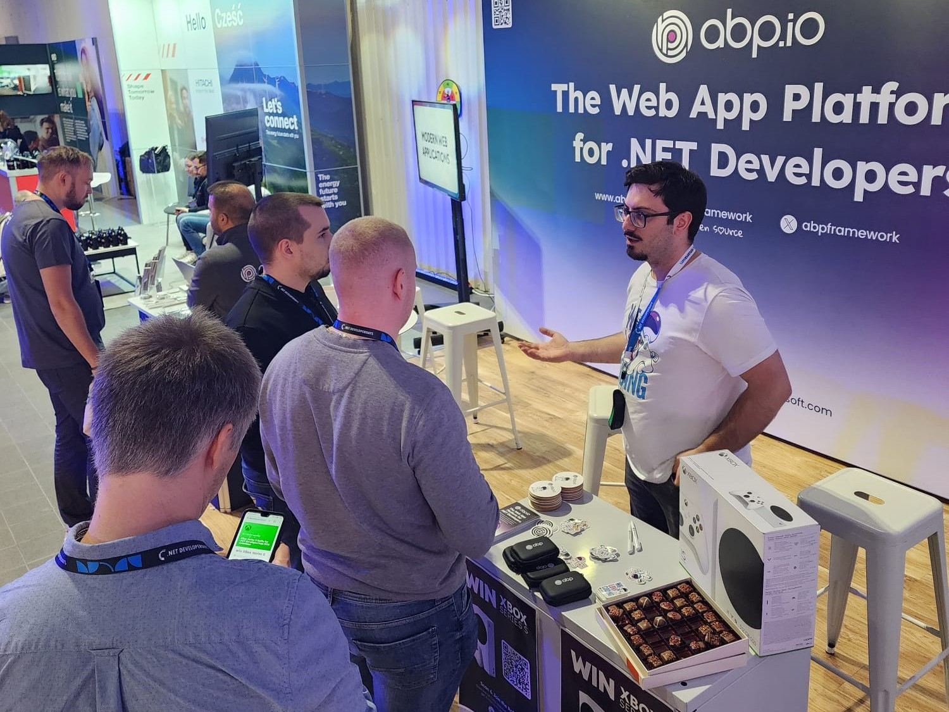
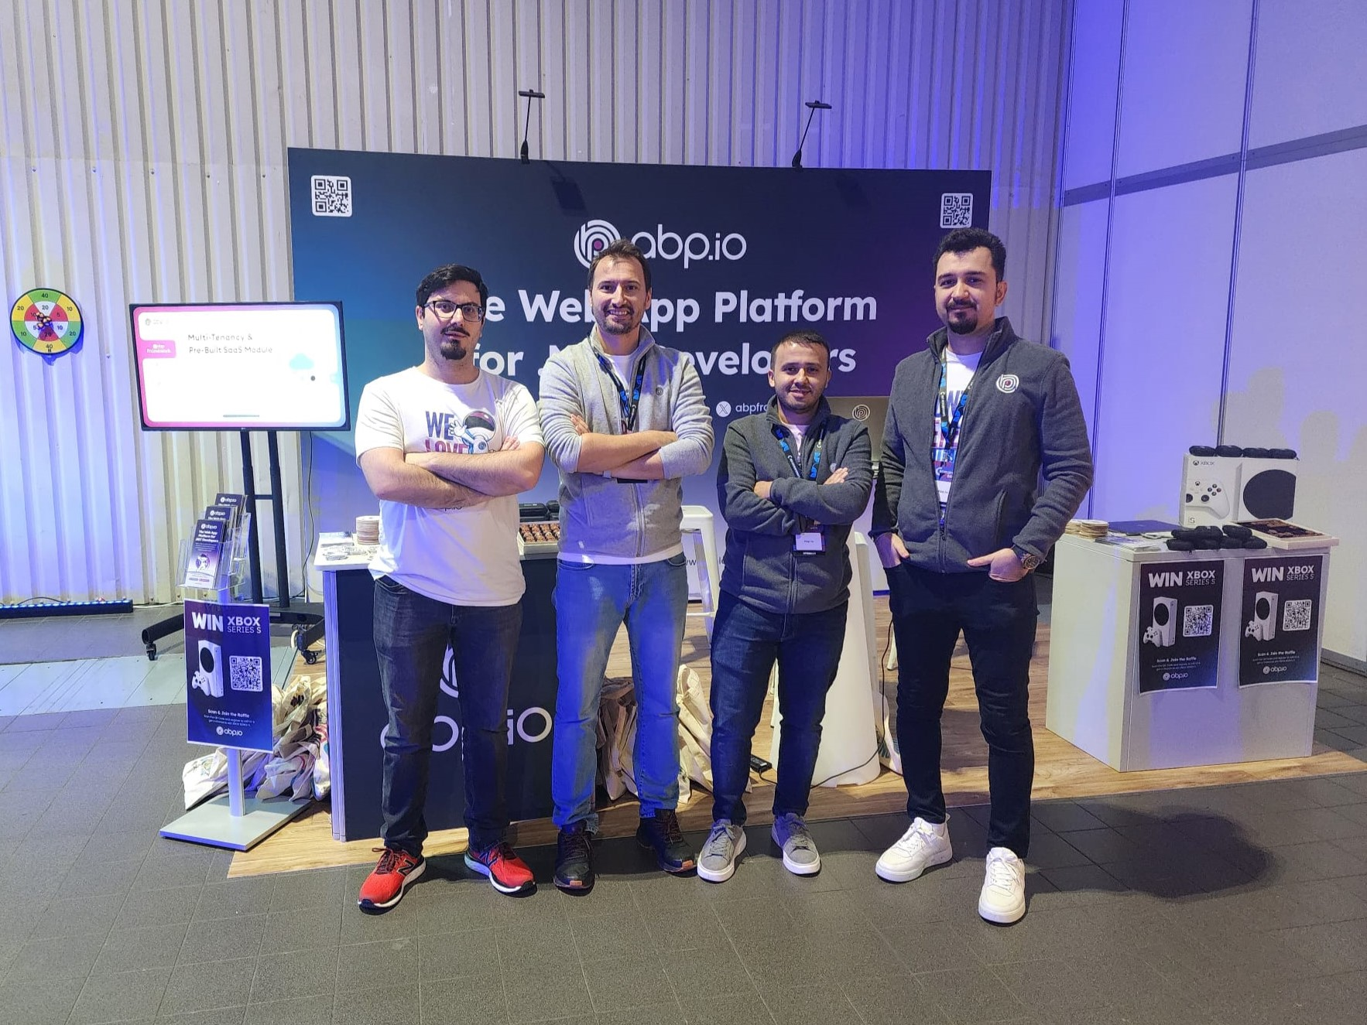

ABP Sponsored 👉 .NET Developer Days 2024 🌍 Poland
https://abp.io/blog/Event-Recap-.NET-Developer-Days-2024
Notes:
.NETDevelopersDays 2024 on October 22-23 - Warsaw, Poland
Meet developers from Poland
800 attendees with more than 30 speakers were in the conference.
Gifted an Xbox Series S to an attendee

Slide 21
ABP Community News
What’s new with ABP 9 ?

Slide 22
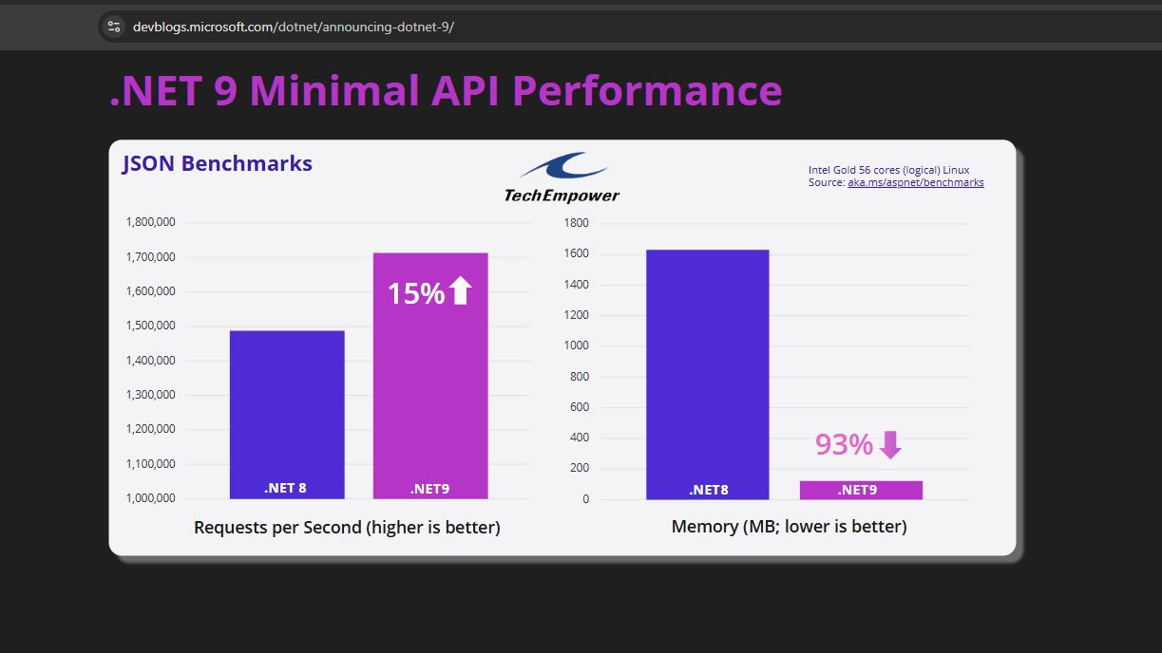

Notes:
Before explaining the ABP9 features, I’d like to show you this benchmark result.
Requests per second %15 increased.
Memory usage is down by %93.
So it’s another reason to update to the latest .NET.

Slide 23
ABP 9 Improvements
Upgrade to .NET 9.0
Extension Property Policy
Wildcard Support for Redirect URLs
Google Cloud Storage BLOB Provider
Removal of React Native from Free Templates
ABP Suite Enhancements
CMS Kit Pro Feedback Feature Improvements
Notes:
Upgrade to .NET 9.0
Aligning with the latest advancements, ABP 9.0 has been upgraded to .NET 9.0.
Extension Property Policy
The new Extension Property Policy feature allows developers to define custom policies for module entity extension properties.
Wildcard Support for Redirect URLs
ABP 9.0 introduces support for wildcards in RedirectAllowedUrls configurations. This enhancement simplifies the management of permitted redirect URLs
Google Cloud Storage BLOB Provider
The new BLOB provider for Google Cloud Storage is implemented.
ABP Suite Enhancements
ABP Suite has been updated to provide better naming conventions for multiple navigation properties to the same entity.
CMS Kit Pro Feedback Feature Improvements
The CMS Kit Pro module's feedback feature has been refined to offer a more user-friendly experience.

Slide 24
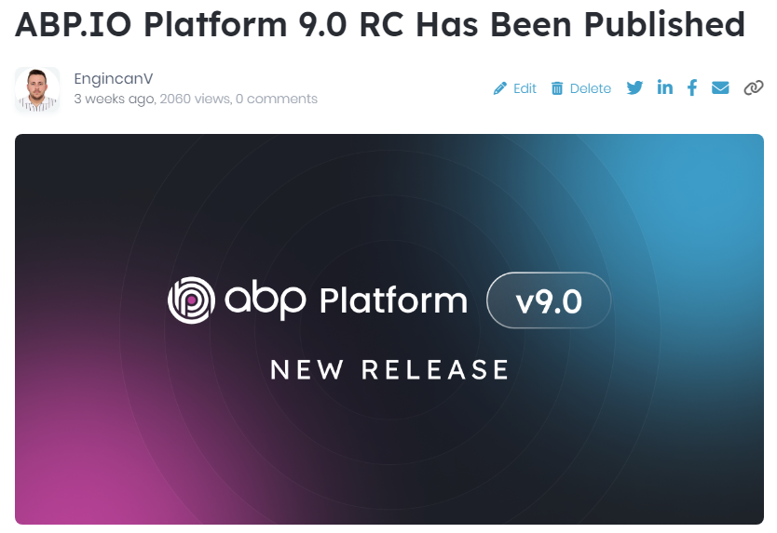

ABP 9 Improvements Explained 👇
https://abp.io/blog/announcing-abp-9-0-release-candidate

Slide 25
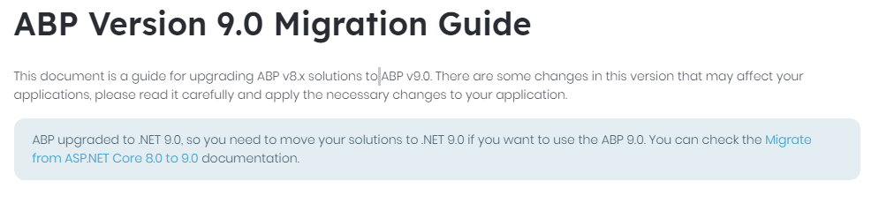

https://abp.io/docs/9.0/release-info/migration-guides/abp-9-0
Notes:
We have a migration guide shows how to upgrade your ABP to version 9.

Slide 26
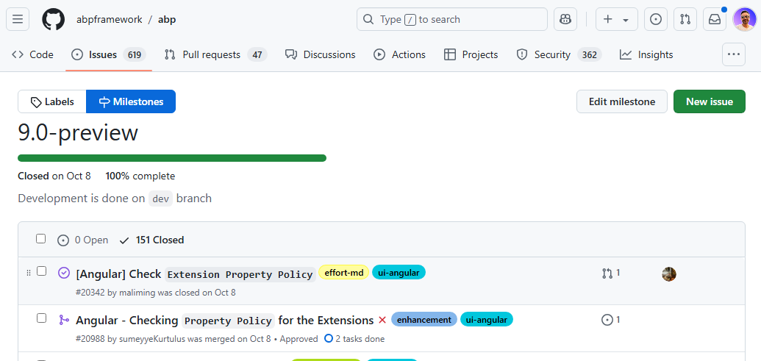

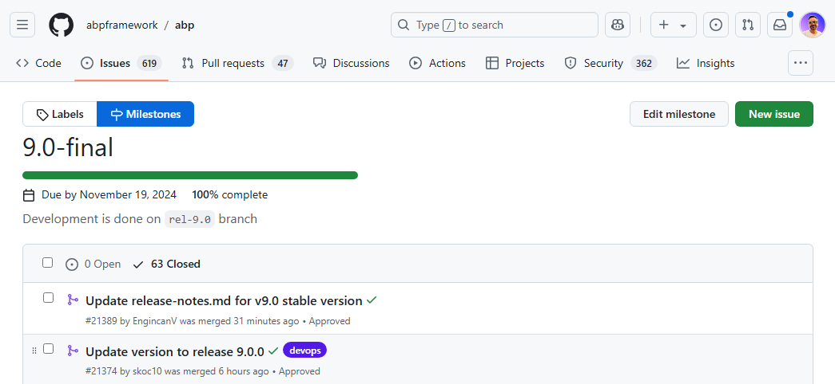

ABP 9 Open-Source Milestone
https://github.com/abpframework/abp/milestone/104?closed=1
https://github.com/abpframework/abp/milestone/110?closed=1

Slide 27
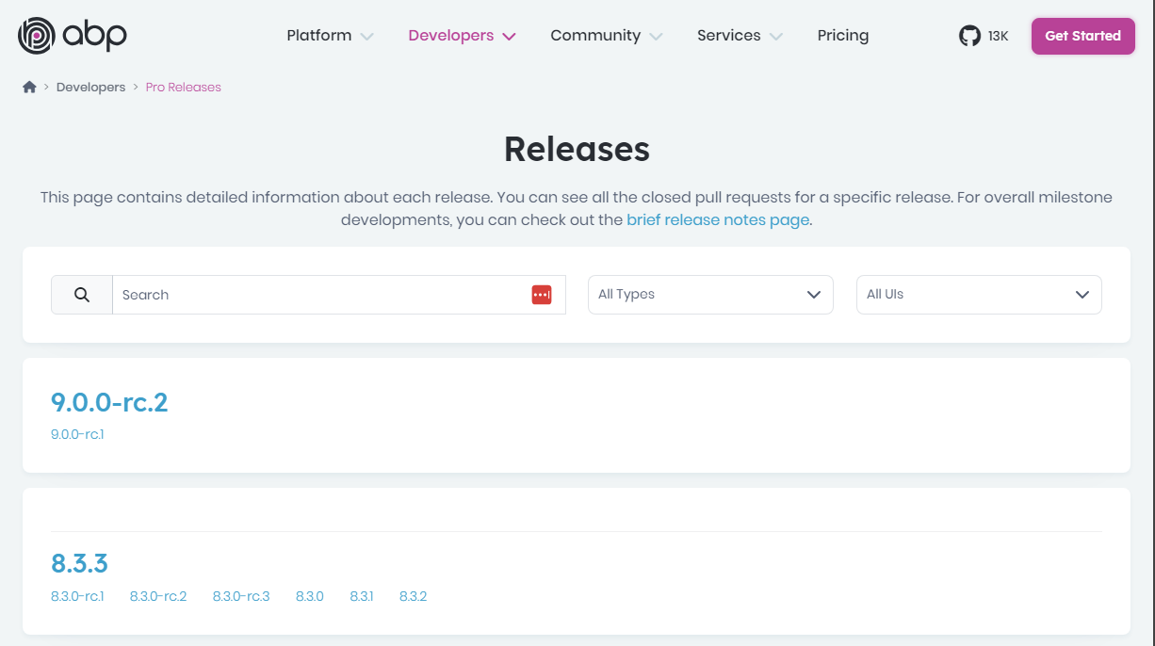

ABP 9 PRO License Improvements
https://abp.io/pro-releases
Notes:
This page contains detailed information about each release.
You can see all the closed pull requests for a specific release.

Slide 28

ABP Studio Improvements
Blazor WebApp UI option for the new startup templates
Set an execution order for Solution Runner
Automate more details on new service creation for a microservice solution
Support multiple concurrent Kubernetes deployment scenarios
Improve ABP Suite code-generation for microservice projects
Improve the module installation experience
Auto-install 3rd party dependencies
Better handle long log files
Allow to directly create new solutions with ABP’s release candidates
Improve client proxy generation experience
Support :
Intel processors for MAC
ARM chipset for Windows
Linux OS
https://abp.io/docs/latest/studio/release-notes
Notes:
ABP Studio has a standalone deployment cycle and We frequently release new versions of ABP Studio.

Slide 29





That’s all from me ☺
Follow me on Twitter
Alper Ebicoglu
https://twitter.com/alperebicoglu
https://github.com/ebicoglu
https://medium.com/@alperonline

